Slide 1

Gadget Galaxy – Electronics E-commerce Mobile Application

Slide 2
GADGET GALAXY
Overview:
Gadget Galaxy is a mobile application providing an all-in-one shopping experience for electronic gadgets.
The project is divided into two parts:
Part 1: MySQL-based relational database design and implementation.
Part 2: Transition to a NoSQL database using MongoDB for enhanced scalability and flexibility

Slide 3
GADGET GALAXY – PHASE 1
In Phase 1, we designed and implemented a relational database using MySQL to manage the structured data of Gadget Galaxy.
This phase involved creating normalized database schemas, establishing relationships between entities.
Optimizing data retrieval through indexing, ensuring data consistency, integrity, and efficient query performance.

Slide 4

MySQL Functional Requirements
1. User Authentication and Registration
User Registration: Users provide username, email, and password.
User Login: Users log in using email and password.
Security: Information stored securely with hashed passwords.
2. Product Management
Seller Registration: Third-party companies register as sellers.
Product Listing: Sellers list and manage products (name, description, price, quantity, category).
3. Product Listings
Browse and Search: Users browse products by categories, keywords, and filters.
4. Shopping Cart and Order Management
Shopping Cart: Users add products to the cart, view contents, and proceed to checkout.
Checkout Process: Secure checkout with order summary and payment integration.
5. User Profiles
Profile Pages: Display order history, contact details, and basic information.
Order History: Users view order history and details.
Seller Profiles: Sellers manage product listings, basic info, and reviews.

Slide 5
MySQL Functional Requirements
1. Database Design
Designed a Normalized relational database schema to store user, product, order, and related information.
2. Security and Privacy
Implemented secure authentication mechanisms to protect sensitive data by storing hashed passwords etc.
3. Performance and Optimization
Ensured efficient retrieval of information by optimizing database queries.
4. User Interface (UI) Design
Designed user-friendly interface mock screens for the application.

Slide 6
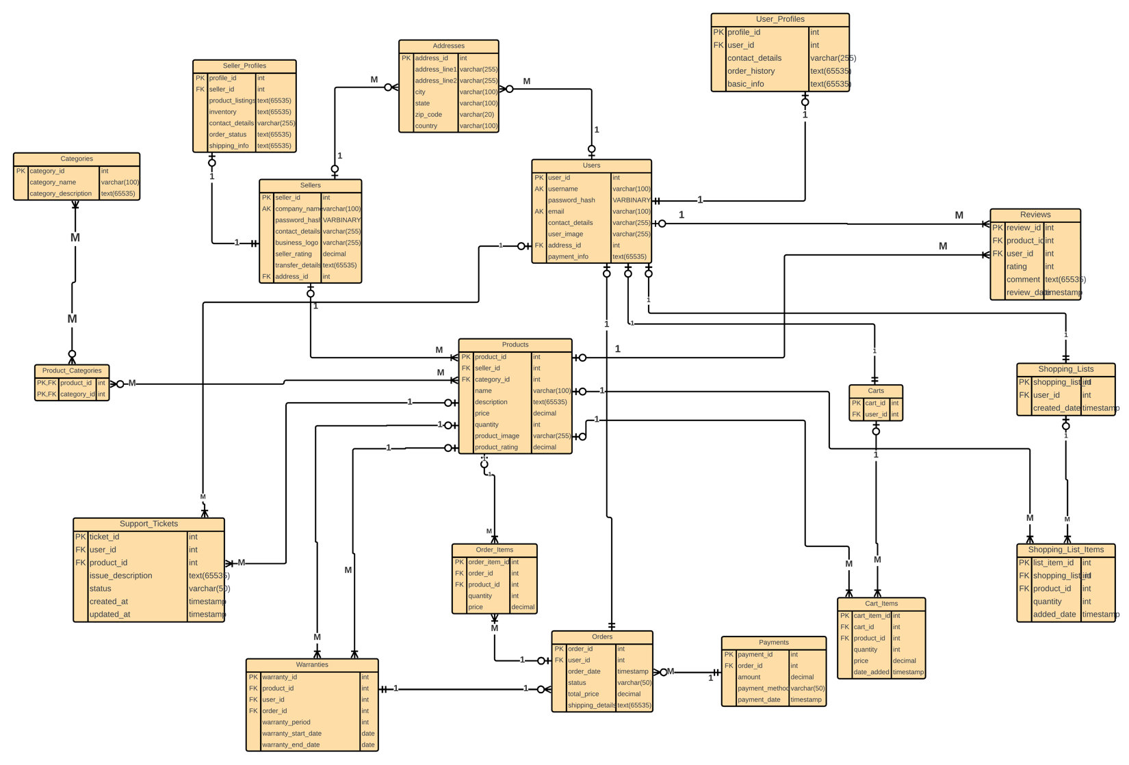
DATABASE DESIGN.
ENTITY RELATIONSHIP DIAGRAM (ERD)

Slide 7
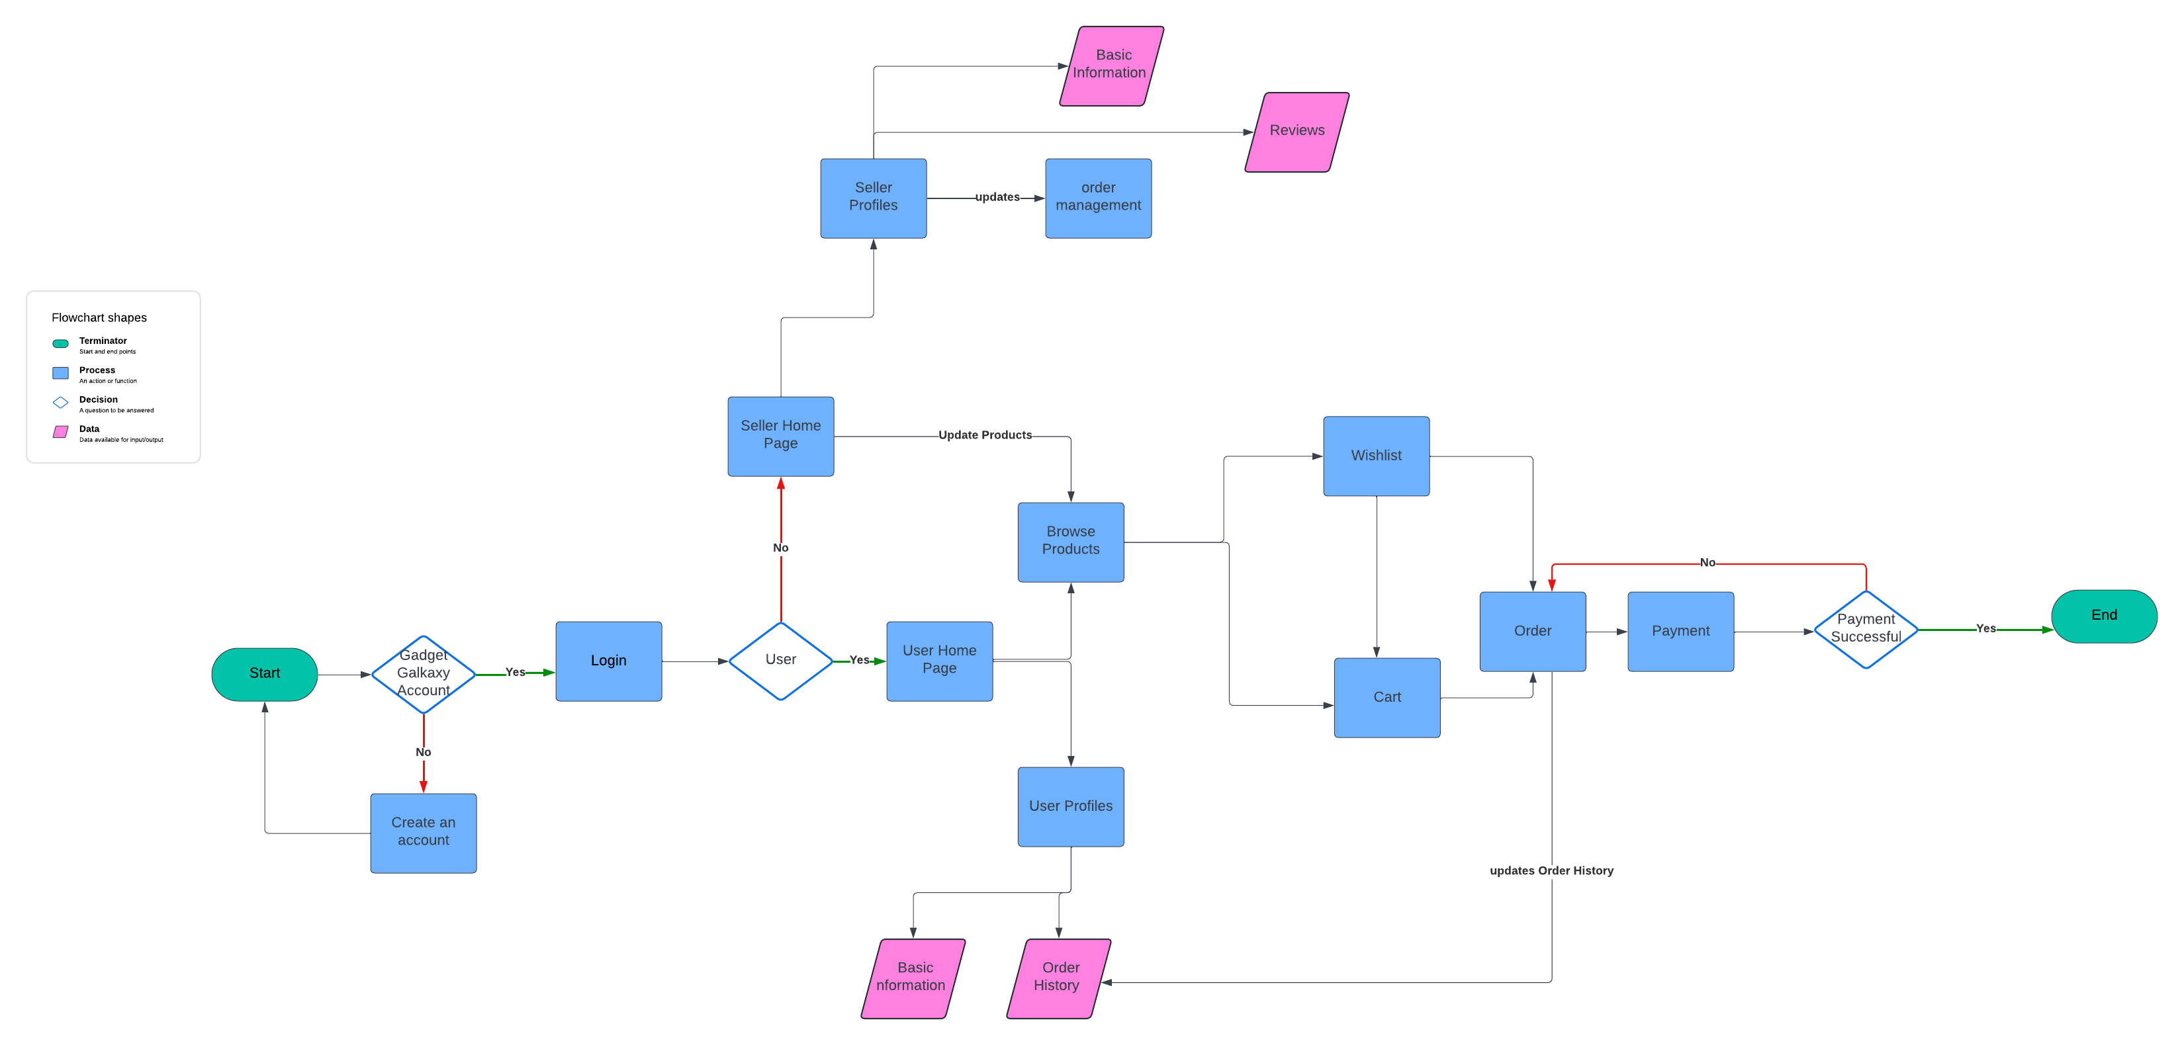
DATA FLOW DIAGRAM

Slide 8
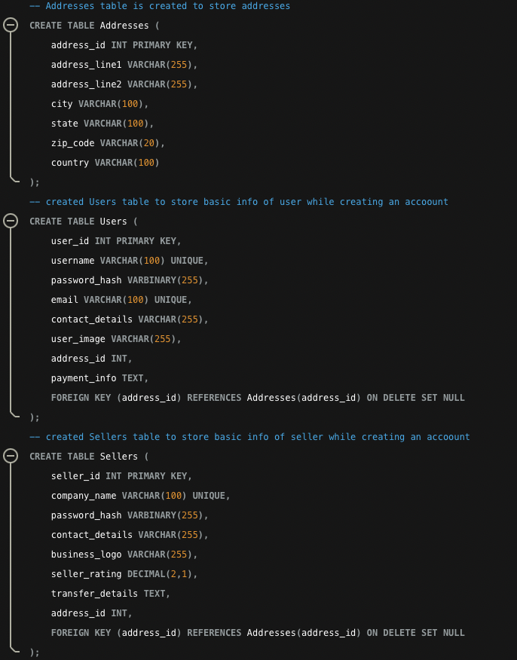
DESIGN TECHNIQUES
1. Normalization
Technique to reduce redundancy and dependency by organizing fields and tables.
Ensure data consistency and integrity while minimizing duplication.
Implementation:
Addresses Table: Stores address details separately; referenced by Users and Sellers tables.
Users and Sellers Tables: Reference Addresses table via foreign key (address_id).

Slide 9
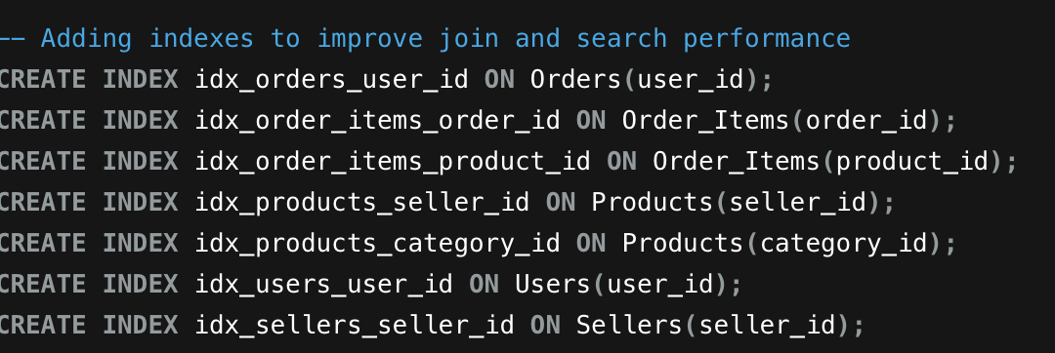
DESIGN TECHNIQUES
2. Indexing
Database optimization technique to improve data retrieval speed and efficiency.
Create indexes on frequently queried columns, especially in WHERE clauses, joins, and sorting operations.
Implementation in GadgetGalaxy:
Created indexes for user orders, product management, and seller profiles.
Ensures quick query execution, providing a smooth experience for users and sellers.

Slide 10
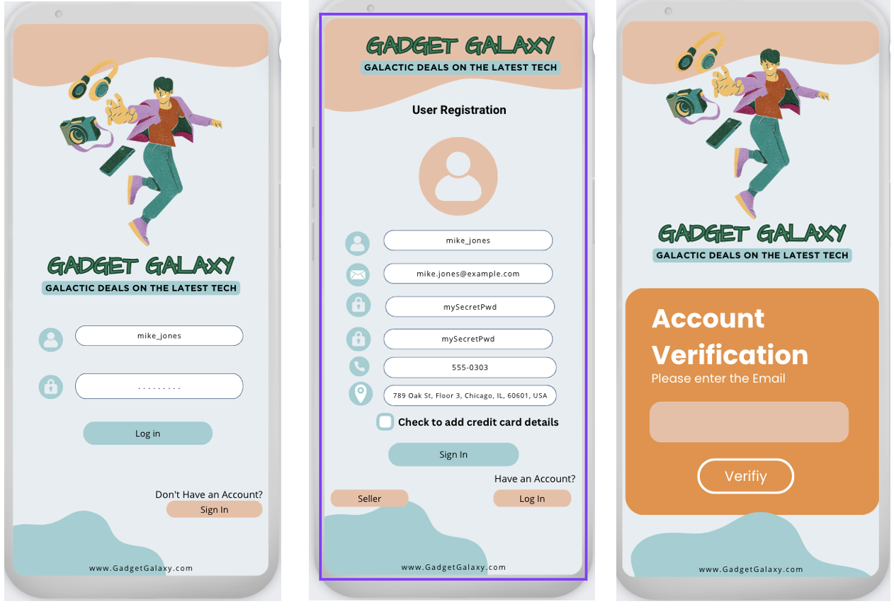
USER AUTHENTICATION AND REGISTRATION
Users provide essential details: username, email, password, and contact information.
Passwords are hashed (e.g., SHA-256) before storage for security.
Existing users log in with their username and password.
Additional email verification if the user cannot log in.

Slide 11
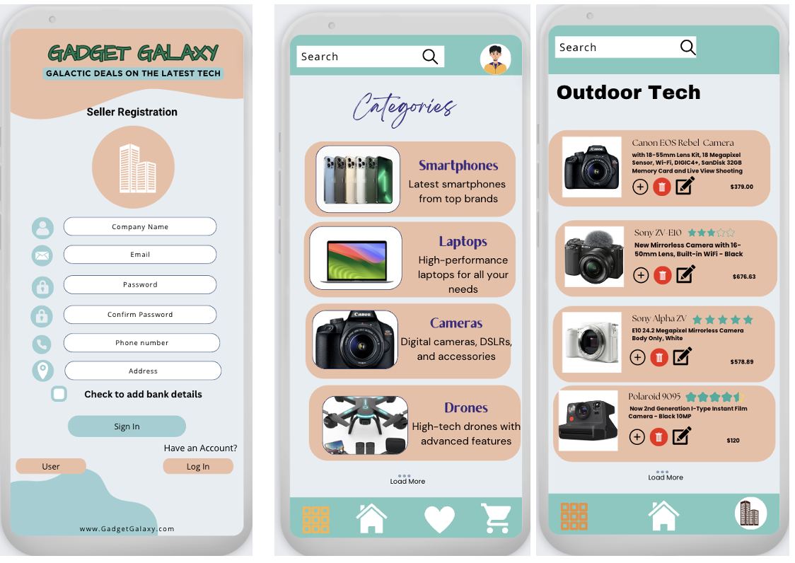
PRODUCT MANAGEMENT
Third-party companies register to join GadgetGalaxy.
Passwords are hashed and securely stored in the Sellers table in the MySQL database.
Sellers can add, edit, and delete products.
Products have attributes like name, description, price, quantity, and category.

Slide 12
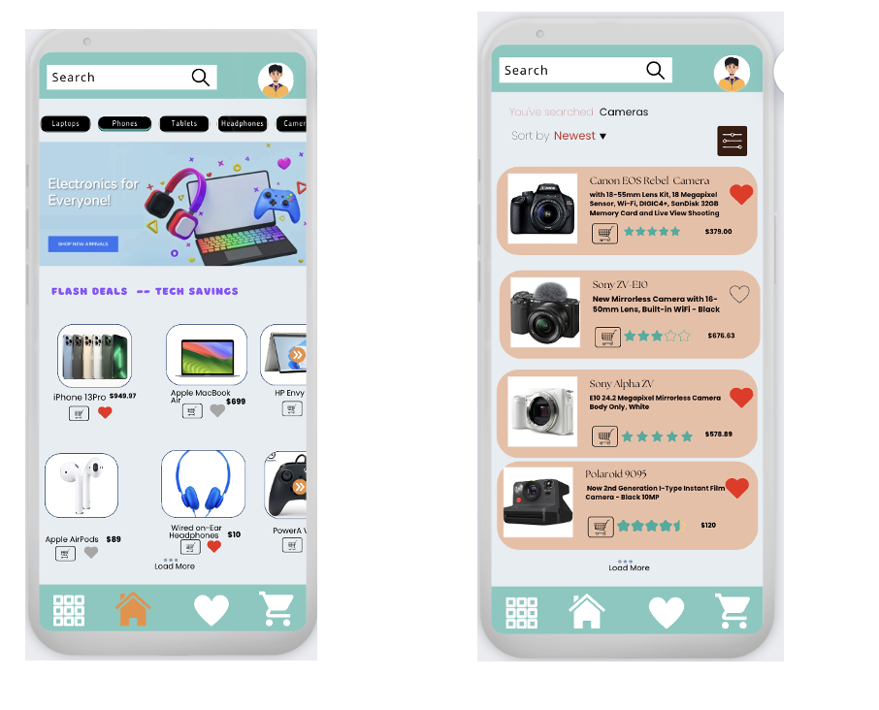
PRODUCT LISTINGS
Users browse products by categories, keywords, and filters.
Detailed product information displayed on individual product pages.

Slide 13
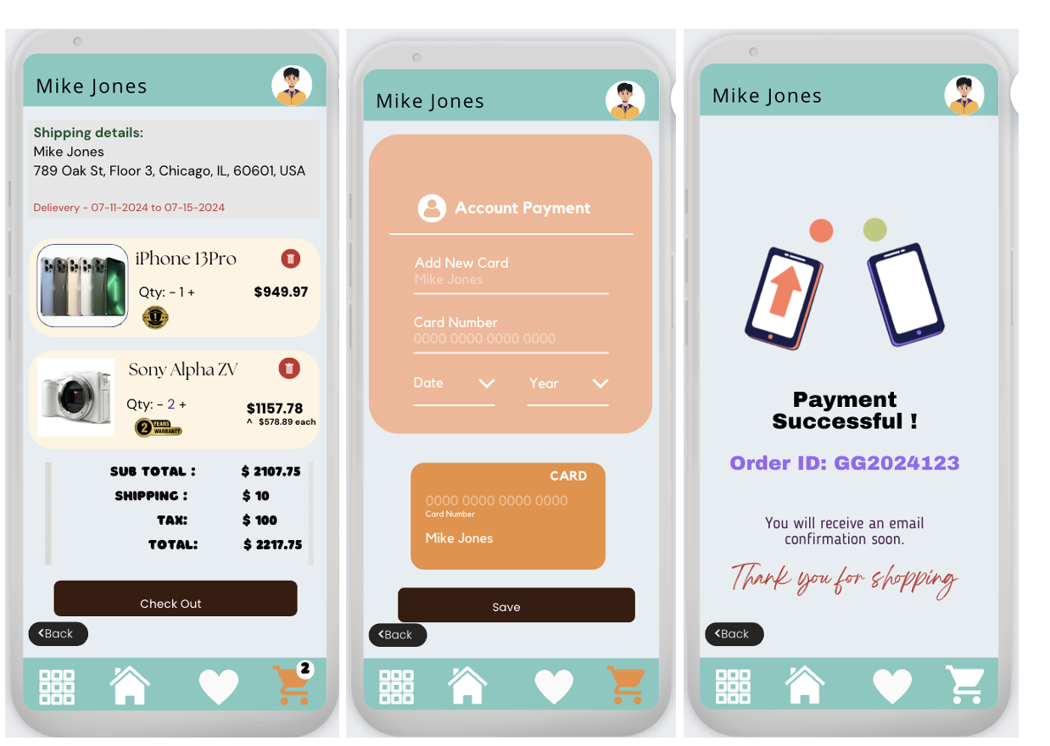
Shopping Cart and Order Management
Users add products to their cart, view contents, and proceed to checkout.
Cart displays selected items with quantities, prices, and total cost.
Secure checkout with order summary and payment integration.
Users receive order confirmation with purchase details and estimated delivery times.

Slide 14
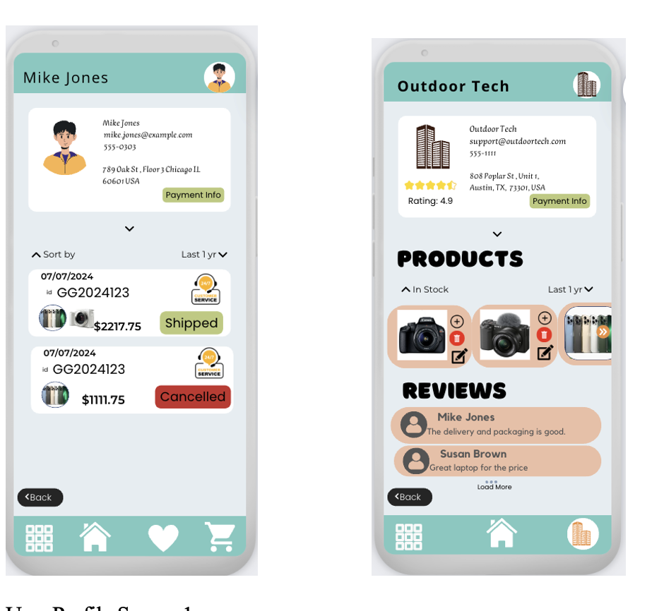
User and Seller Profiles
Display order history, contact details, and basic information.
Users view detailed order history including dates, product details, and total amount spent.
Manage product listings, view sales data, and update business information.
Sellers see user reviews and can add, edit, and remove products.

Slide 15
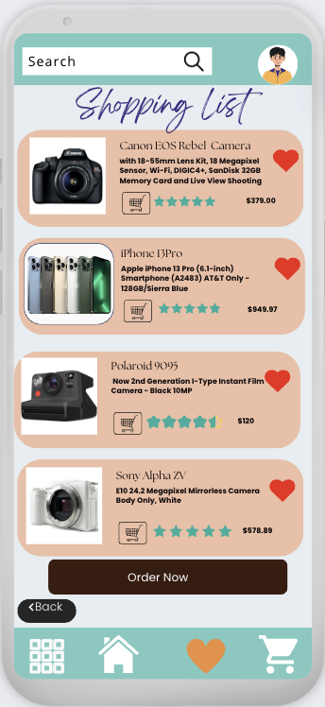
Related tables
Support Tickets:
Users raise issues or queries related to purchases.
Includes user ID, product ID, issue description, status, and timestamps.
Warranties:
Stores warranty information for purchased products.
Includes warranty period, start and end dates, order ID, and product ID.
Shopping Lists:
Users create personalized lists of products for future reference.
Each list can contain multiple items linked to specific products.
Addresses:
Stores address details separately to avoid redundancy.

Slide 16
ADDRESSING QUERIES WITH SQL
The business questions: :These aim to provide insights into the operational aspects of the e-commerce platform. These questions include determining the total number of registered vendors and comparing the number of active versus inactive vendors for the current month.
Customer questions: These focus on providing personalized insights and details to enhance user experience and engagement. These insights can be instrumental in building customer loyalty and tailoring marketing efforts to individual customer needs.
Operations questions: These are crucial for maintaining and optimizing the performance of the database. Determining the size of the MySQL database is vital for understanding storage requirements and planning for future expansions. By addressing these questions, the platform can ensure that it remains scalable and capable of handling increasing data loads without compromising performance.

Slide 17
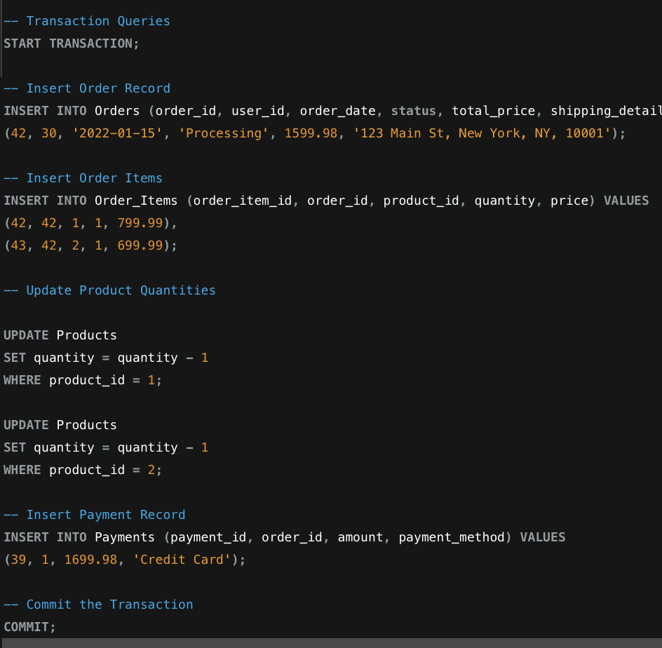
ADDRESSING QUERIES WITH SQL
Transaction Queries: Placing an Order When a user places an order, several operations occur, including creating an order record, adding items to the order, updating product inventory, and recording the payment. To ensure all these operations are executed successfully, transactions are used.
Measures of the Impact on Data Retrieval: Indexes are critical for optimizing database performance by speeding up data retrieval operations. The EXPLAIN statement can be used to verify that the index is being utilized efficiently, confirming the optimization of query execution.

Slide 18

CONCLUSION – PHASE 1
In Phase 1 of the Gadget Galaxy project, we successfully designed and implemented an efficient MySQL relational database.
This phase focused on establishing a well-structured and normalized database schema to manage user authentication, product management, shopping cart functionality, order management, and user profiles.
By utilizing effective normalization techniques, we ensured data consistency, minimized redundancy, and optimized data storage and retrieval processes.
The implementation of secure authentication mechanisms, along with efficient indexing strategies, enhanced the performance and reliability of the database.
We addressed various business and customer requirements through tailored SQL queries, providing valuable insights and improving user experience.
This foundational work in Phase 1 has set the stage for transitioning to a more scalable and flexible NoSQL database in Phase 2, ensuring that Gadget Galaxy can efficiently handle growing data volumes and complex queries while maintaining high performance and data integrity.

Slide 19
GADGET GALAXY – PHASE 1I
In Phase II, Gadget Galaxy is transitioned to a NoSQL database using MongoDB.
This phase enhances scalability and flexibility of the application.
We implement data modeling, data migration, and advanced querying mechanisms.

Slide 20
WHY MONGODB?
Flexible Data Model:
Handles diverse product attributes and specifications.
Supports a dynamic schema, accommodating varying product categories and changing data structures.
High Performance:
Efficient storage format and indexing capabilities.
Enhances search speed, crucial for responsive e-commerce platforms.
Powerful Query Language:
Supports complex queries, aggregations, and geo-spatial searches.
Essential for advanced product searches, filtering, and sorting.
Data Consistency:
Ensures data consistency and integrity.
Supports multi-document transactions with ACID compliance, crucial for financial transactions and inventory management.
Developer-Friendly:
JSON-like document structure simplifies development.
Integrates well with various programming languages and frameworks.

Slide 21
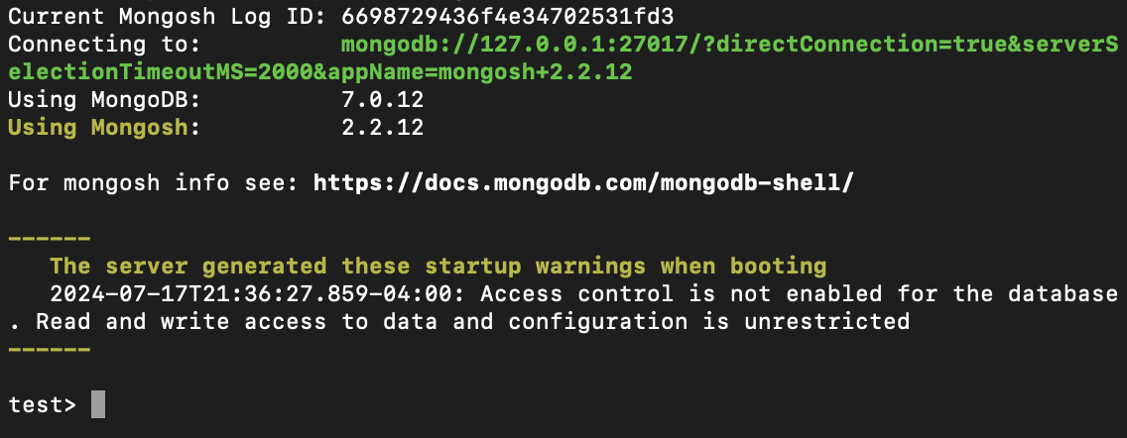
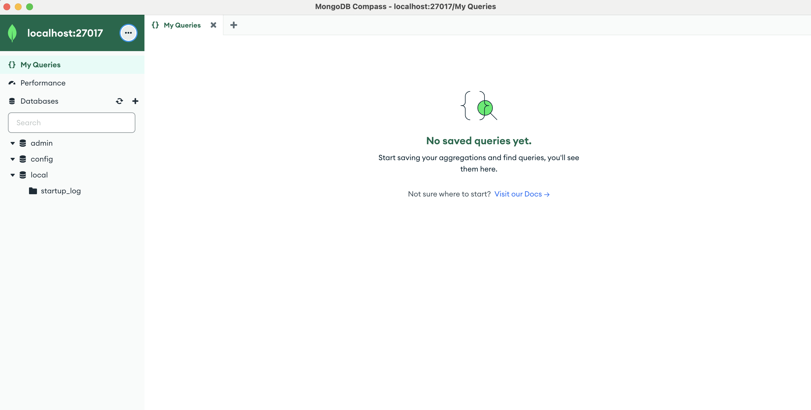
INSTALLATION & SETUP
Install MongoDB : We used Homebrew commands for installing in Mac OS
brew tap mongodb/brew
brew install mongodb/brew/mongodb-community
brew install mongosh
brew install --cask mongodb-compass
Verify Installation: Verify the version
mongod –version
mongosh –version

Slide 22
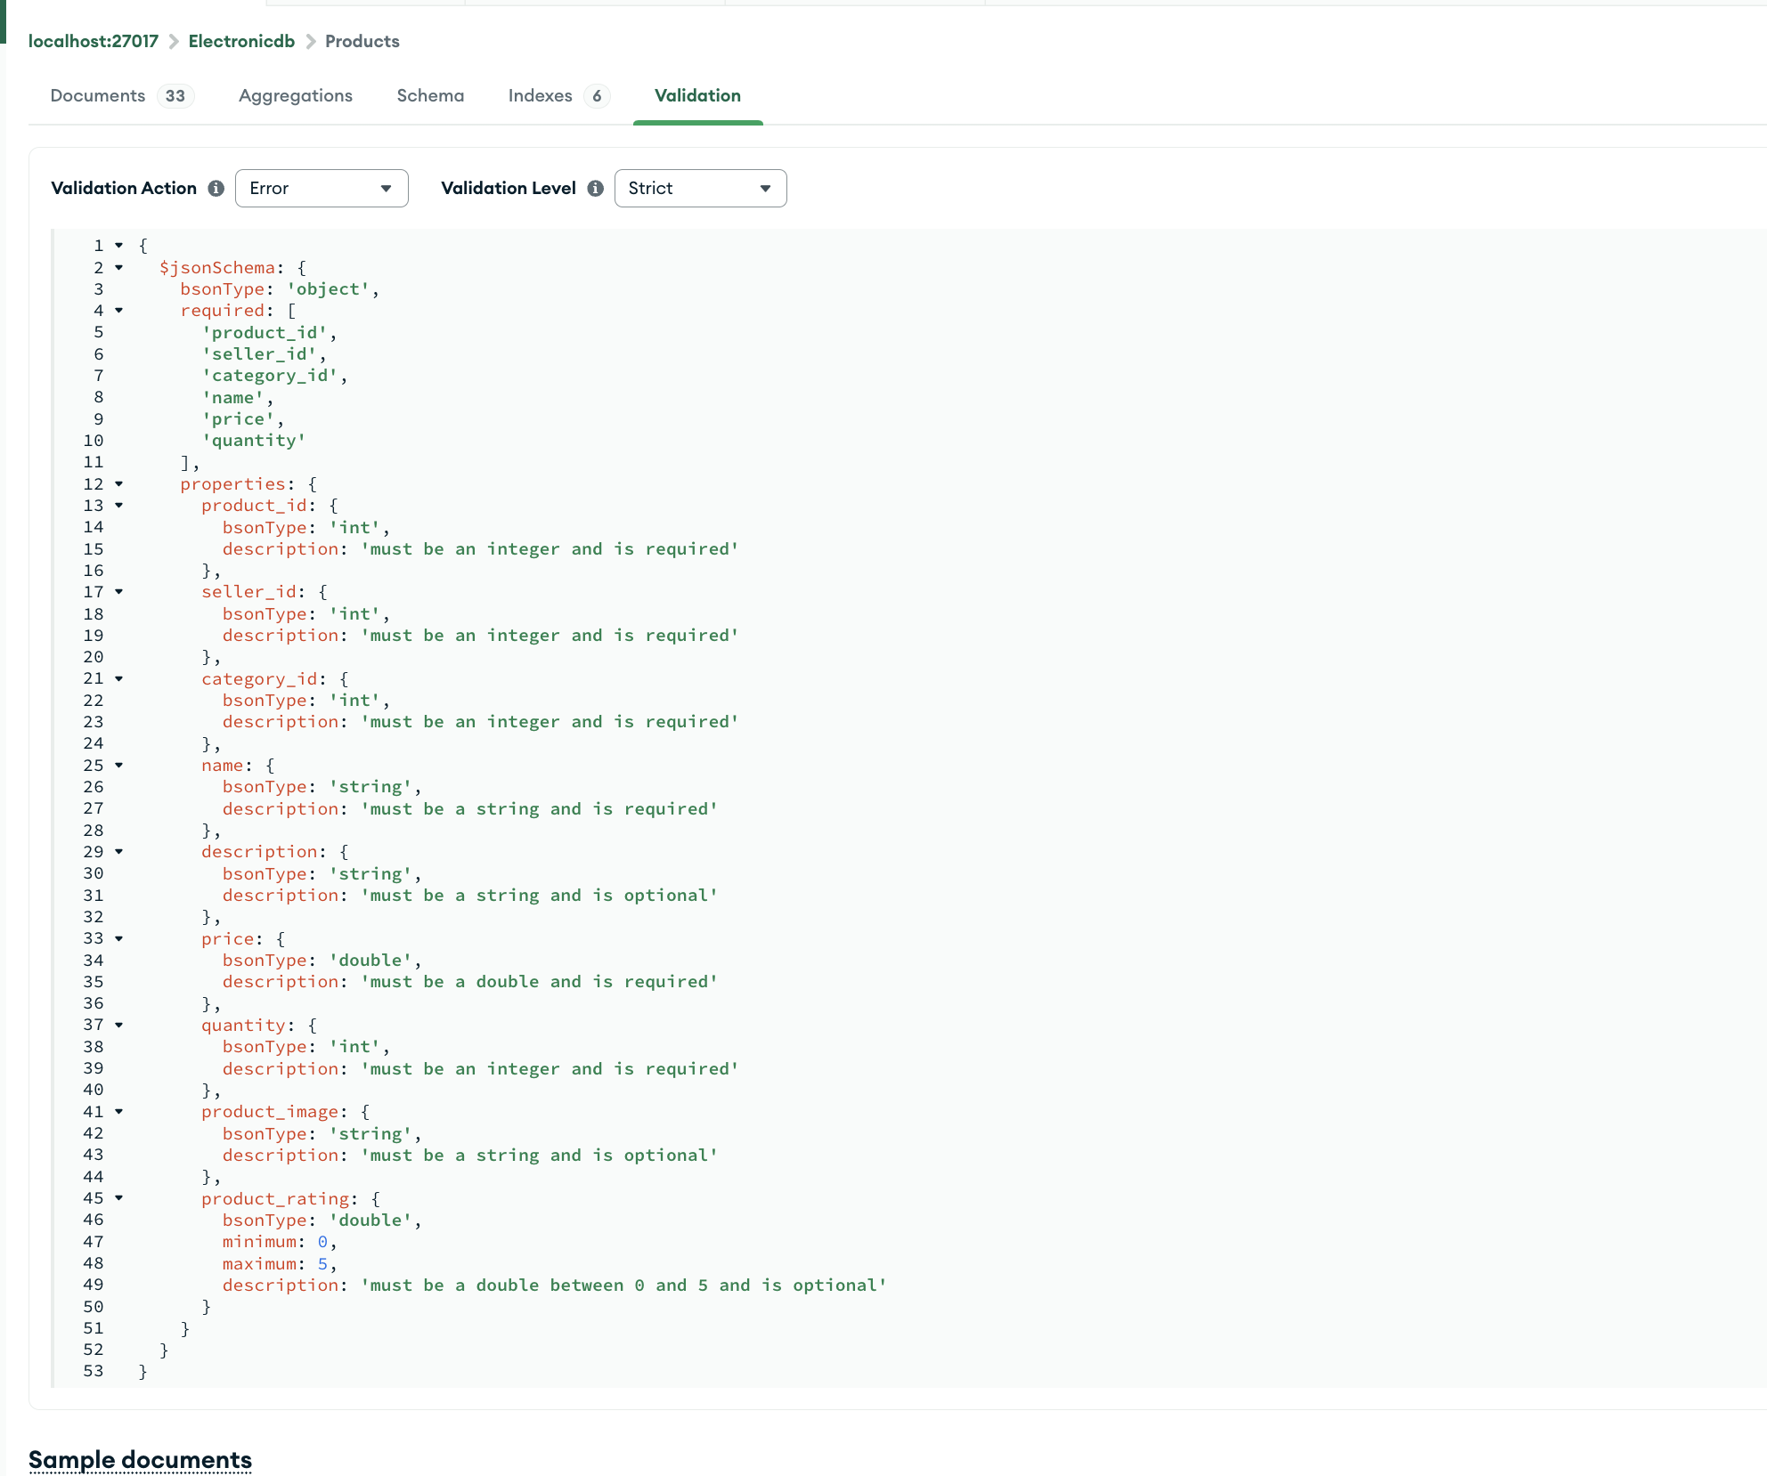
DATA MODELING
Translating Tables to Collections:
MongoDB collections correspond to tables, and documents represent rows.
Key considerations: data type mapping, schema design, validation, and performance optimization.
Schema-less Nature:
MongoDB does not have a schema at the database level but schema validation can be implemented.
Schema Validation:
MongoDB provides JSON Schema validation to ensure data integrity.

Slide 23
DATA MIGRATION
Install Studio 3T
Migration:
Source: Choose MySQL connection and the databasewe want to migrate.
Target: Choose our MongoDB connection and the database/collection where you want the data to go.
Data Mapping and Transformation: Map SQL Tables to MongoDB Collections. Studio 3T allows you to map SQL tables directly to MongoDB collections.
Execute Migration: Review the mapping and transformation settings. Click Run Migration to begin the migration process.
After the migration completes, verify that the data has been correctly migrated to MongoDB.

Slide 24
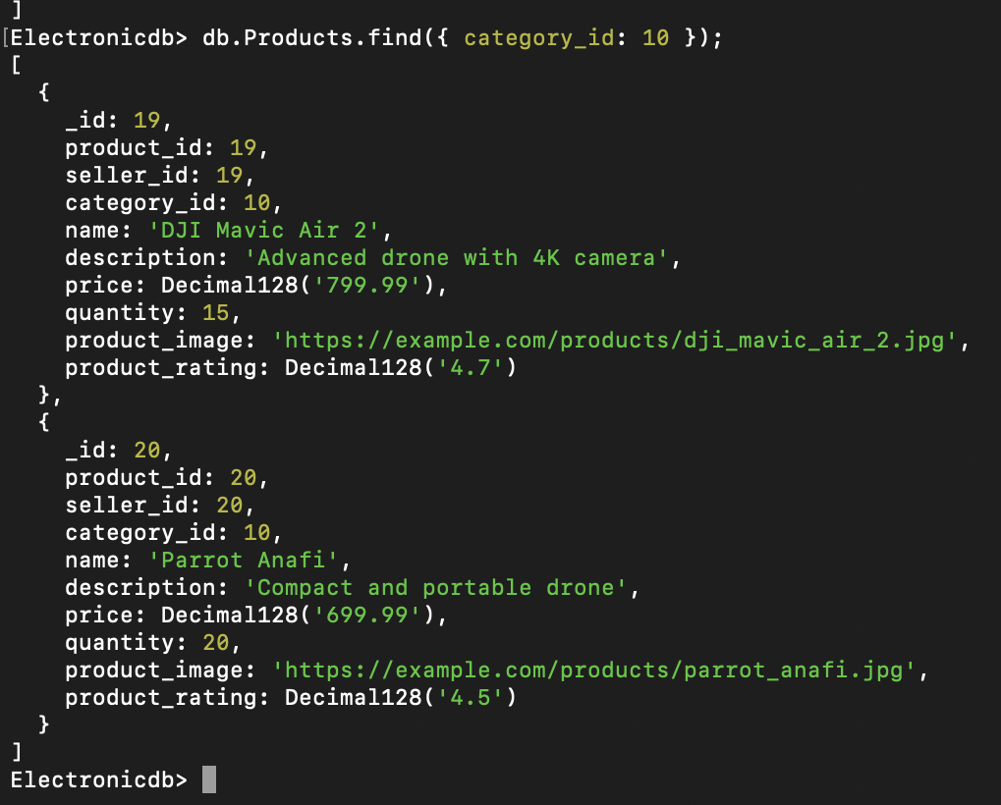
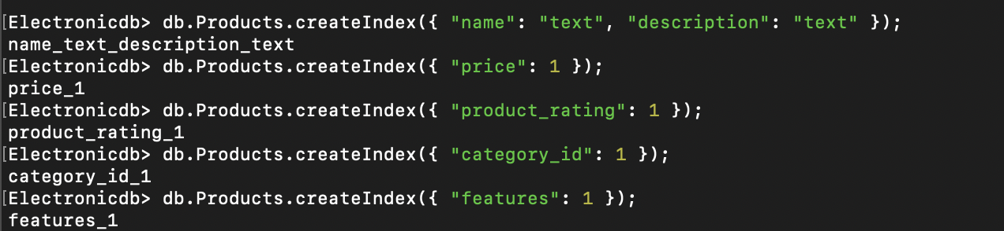
Product Listings and Search (NoSQL) Optimization Techniques:
Indexing for enhanced search performance.
Text search, filter by price, category, and sort by rating.

Slide 25
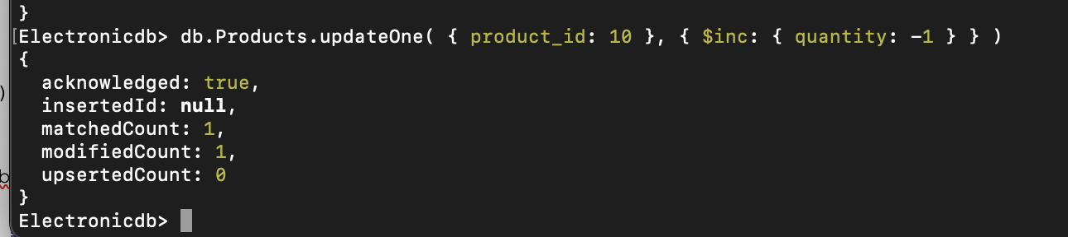
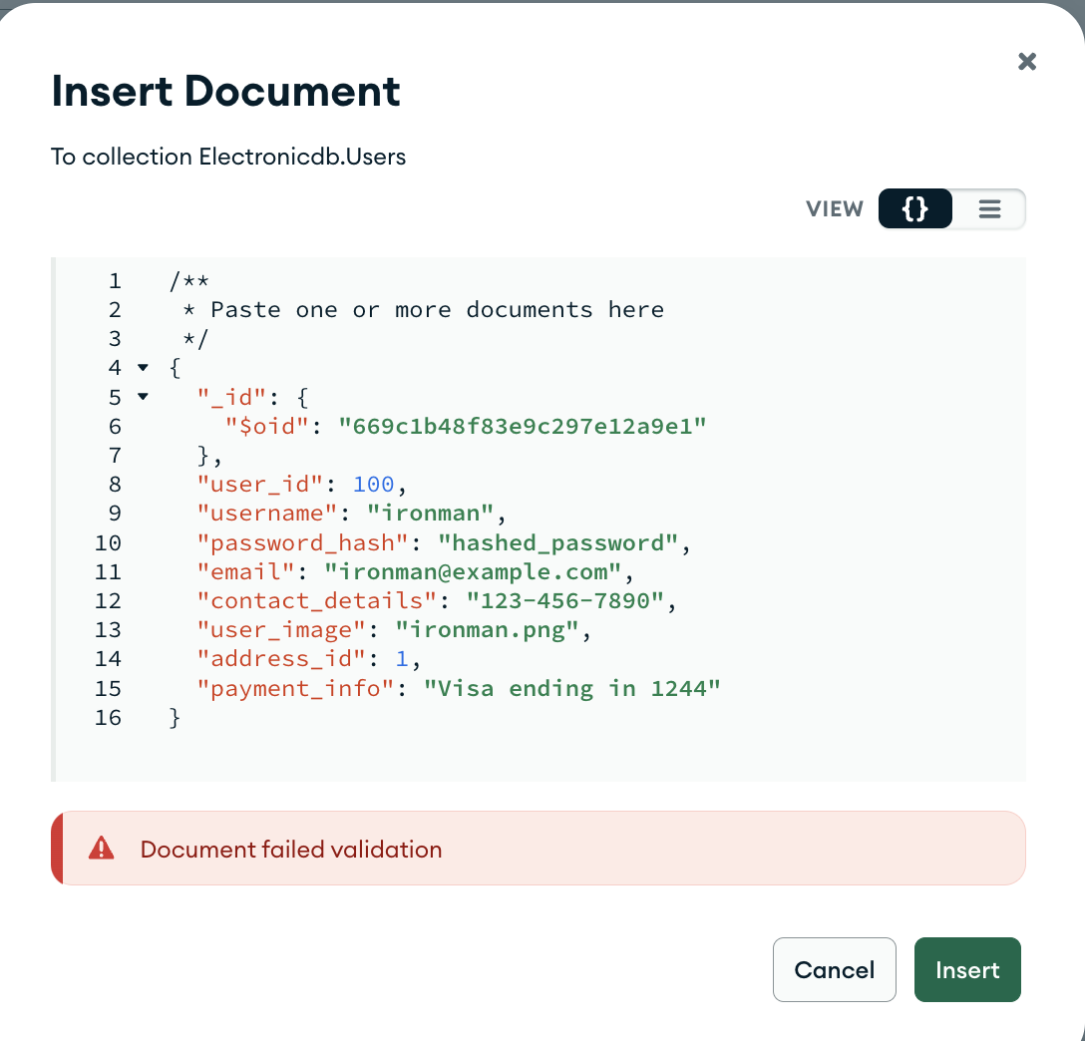
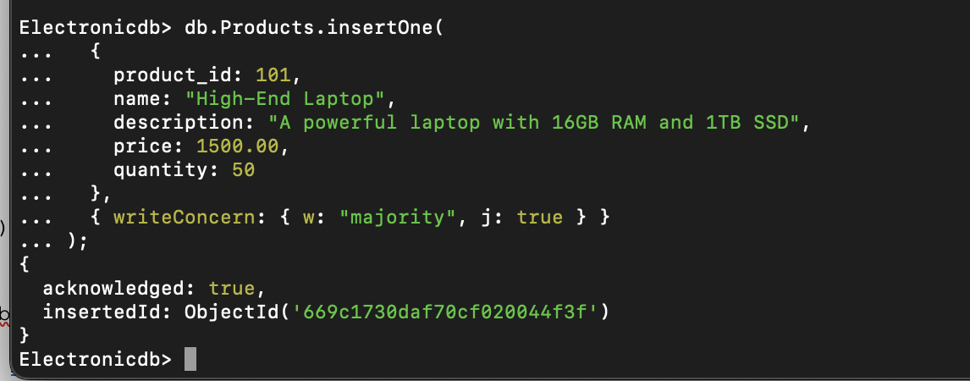
DATA CONSISTENCY AND INTEGRITY
Atomic operations for single-document transactions.
Schema validation using JSON Schema.
Unique indexes and write concern for data durability.
Write Concern Levels

Slide 26
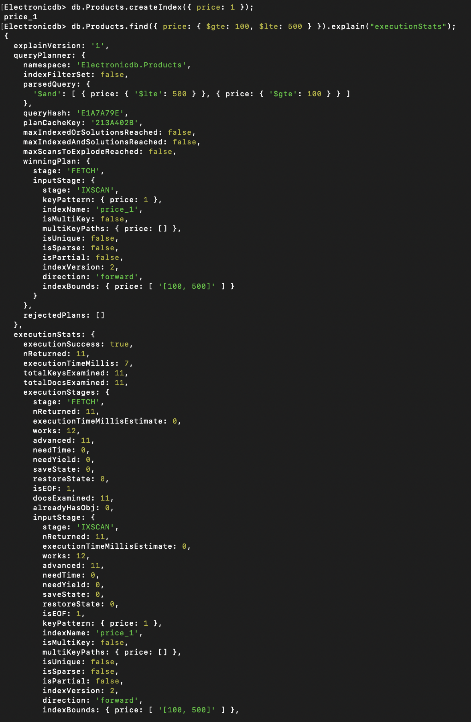
SCALABILITY AND PERFORMANCE TESTING
The execution statistics of the index-augmented query show that the index scan (IXSCAN) operation is the initial stage in query resolution. This demonstrates that the index is correctly identified and applied by the MongoDB query optimizer.

Slide 27
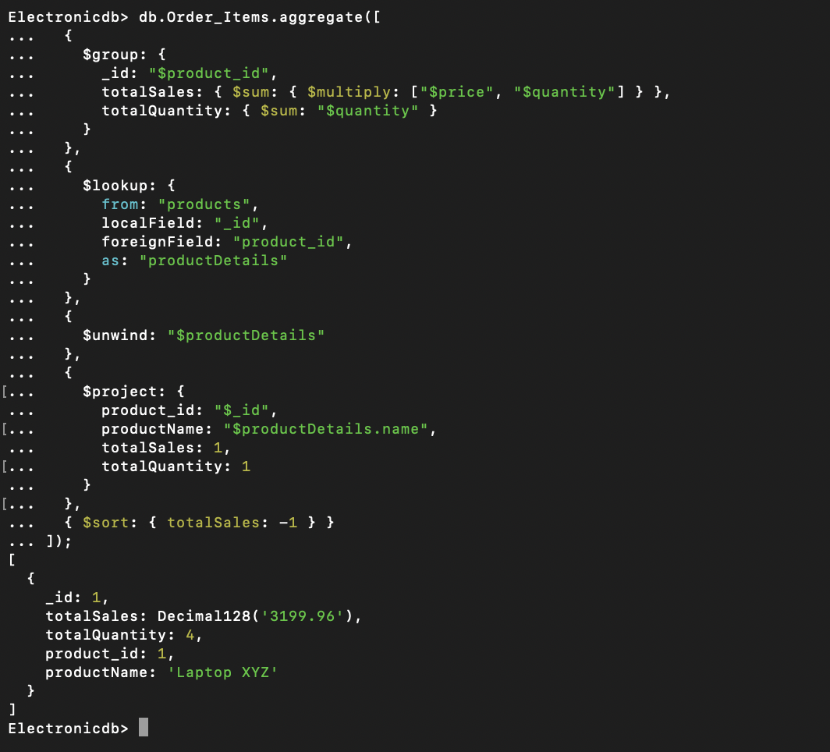
ANALYTICAL QUERIES
This query calculates the total sales and total quantity for each product from the Order_Items collection.
Groups documents by product_id and calculates totalSales and totalQuantity
.
Performs a left outer join with the products collection.
Deconstructs the productDetails array into individual documents.
Reshapes the documents to include product_id, productName, totalSales, and totalQuantity.
Sorts the documents by totalSales in descending order.

Slide 28
NOSQL QUERIES
Aggregation Queries like total Sales and Quantity per Product:
Various examples of Business Insights like identifying most expensive orders, top vendors by revenue:
Created indexes on frequently queried fields to speed up data retrieval and used the explain function to verify the effectiveness of indexes.
Implemented text search capabilities to allow users to perform keyword-based searches.

Slide 29
CONCLUSION
The transition to a NoSQL database like MongoDB for managing electronic product e-commerce data for Gadget Galaxy offered substantial benefits in terms of scalability, flexibility, and performance.
By using MongoDB’s indexing capabilities, we achieved significant query performance improvements. The use of the explain function validated that indexes were effectively utilized for range queries, optimizing execution paths, and minimizing unnecessary collection scans.
Furthermore, the implementation of various simple and complex NoSQL queries allowed us to extract critical business insights, such as identifying the most expensive orders, calculating total historical spend, and determining the top vendors by revenue.
Ensuring data consistency and integrity through schema validation, atomic operations, and transactions further reinforced the reliability of our data.

Slide 30
Improvements
Improving Security Measures:
Adding encryption techniques to protect sensitive data.
Implement role-based access control to ensure appropriate permissions and data security.
Integrate Advanced Technologies:
Incorporate machine learning algorithms to analyze data and provide insights.
Utilize real-time data processing frameworks to handle and process data efficiently.
User Interface and Functionality Enhancements:
Develop the user interface similar to mock screens , ensuring it connects seamlessly with the database. Making sure the integration results in a fully functional and efficient working model.

Slide 31


Slide 32


